Slide 1
MFAD · MINI PROJECT
A Linear Algebra Based Music Recommendation System Using Vector Similarity
Vectors · Matrices · Dot Product · Norms · Cosine Similarity · PCA
Team members:
1)Siddhanth T Murthy (PES1UG25AM388)
2)Siddharth K (PES1UG25AM389)
3)Prasad M (PES1UG26AM815)
4)Siddharth M R (PES1UG25AM391)
Notes:
Introduce the project: we use linear algebra to recommend songs similar to a user's favourite.

Slide 2
Problem Statement & Objectives
The problem
Objectives
Millions of songs, one listener. How can a computer decide that two songs “sound alike”?
Idea: describe every song by numbers (energy, danceability, …) so that “similar songs” becomes “similar vectors”.
Represent songs as vectors and the dataset as a matrix
Normalise features so none dominates
Measure similarity with dot product, norms and angle
Rank songs to give Top-N recommendations
Use PCA (eigenvectors) to visualise the music space
Notes:
Streaming platforms recommend songs. We show the maths behind it using only linear algebra.

Slide 3
Step 1 · Songs as Vectors, Dataset as a Matrix
Song | Energy | Dance. | Acoustic. | Valence | Tempo
Blinding Lights | 0.80 | 0.51 | 0.00 | 0.33 | 171
Radioactive | 0.78 | 0.45 | 0.10 | 0.24 | 136
Lose Yourself | 0.73 | 0.69 | 0.01 | 0.06 | 171
Lovely | 0.30 | 0.35 | 0.93 | 0.12 | 115
S₁ = [0.80, 0.51, 0.00, 0.33, 171]
X = [S₁; S₂; … ; S₃₈] (38×5)
Why vectors?
A vector places each song as a point in feature space. Close points / similar directions ⇒ similar songs. The matrix X lets us process all songs in one operation.
Features: energy · danceability · acousticness · valence · tempo
Notes:
Each row is a song vector in 5-dimensional space; stacking rows gives the feature matrix X (n x 5). We used 38 songs.

Slide 4
Step 2 · Normalisation (Min–Max Scaling)
x′ = (x − min) / (max − min)
applied to every column of X
Result: Blinding Lights
raw = [0.80, 0.51, 0.00, 0.33, 171]
Why normalise?
Tempo is 72–171 while others are 0–1
Without scaling, tempo decides almost everything
After scaling every feature contributes fairly
norm = [0.849, 0.441, 0.000, 0.300, 1.000]
All 38×5 entries now lie in [0, 1]; tempo 171 BPM → 1.0, 72 BPM → 0.0.
Notes:
Tempo in BPM would dominate the dot product, so each column is rescaled to the range 0 to 1.

Slide 5
Step 3 · Dot Product and Norms
S₁′ (Blinding Lights) = [0.849, 0.441, 0.000, 0.300, 1.000]
S₂′ (Radioactive) = [0.822, 0.353, 0.108, 0.200, 0.646]
Dot product = feature alignment
Norm = vector magnitude
S₁′·S₂′ = Σ s₁ᵢ s₂ᵢ
= 0.698+0.156+0+0.060+0.646
= 1.5602
‖v‖ = √(v·v)
‖S₁′‖ = 1.4163
‖S₂′‖ = 1.1268
Large when both songs are high or low in the same features.
Dividing by norms removes magnitude so only direction (taste) is compared.
Notes:
Worked example: user's song Blinding Lights vs recommended song Radioactive, using normalised vectors.

Slide 6
Step 4 · Cosine Similarity and Angle
cos θ = (S₁′ · S₂′) / (‖S₁′‖ ‖S₂′‖)
cos θ = 1.5602 / (1.4163 × 1.1268) = 0.9777
θ = arccos(0.9777) = 12.13°
Interpretation
Why cosine?
cos θ = 1 → same direction
cos θ = 0 → unrelated
Here 12° ⇒ very similar songs
It compares the shape of the taste profile, not its size, and is cheap to compute for every song.
Notes:
cos(theta)=dot/(norm*norm). Angle theta = arccos(cos).

Slide 7
Step 5 · System Pipeline and Matrix Operations
Dataset
Feature
matrix X
Normalise
Preference
vector p
Cosine
scores
Top-N
ranking
→
→
→
→
→
Matrix operations
Taste profile (projection idea)
p = mean of favourite vectors
scores = (X′·p)/(‖X′ᵢ‖‖p‖)
Sim = X̂ X̂ᵀ (38×38)
Choosing several favourite songs averages their vectors into one preference vector p. The best songs are those whose vectors make the smallest angle with p.
X̂ = rows of X′ divided by their norms.
Notes:
All songs are scored with one matrix-vector product, then sorted.

Slide 8
Result · Recommendations for “Blinding Lights”
Why these songs?
High-energy tracks with similar valence and mid-to-low danceability
Low acousticness like the input
Scores 0.94–0.98 (angles ≈ 12°–20°)
Notes:
Top 5 by cosine similarity from the 38-song dataset. The axis starts at 0.9 to make differences visible.

Slide 9
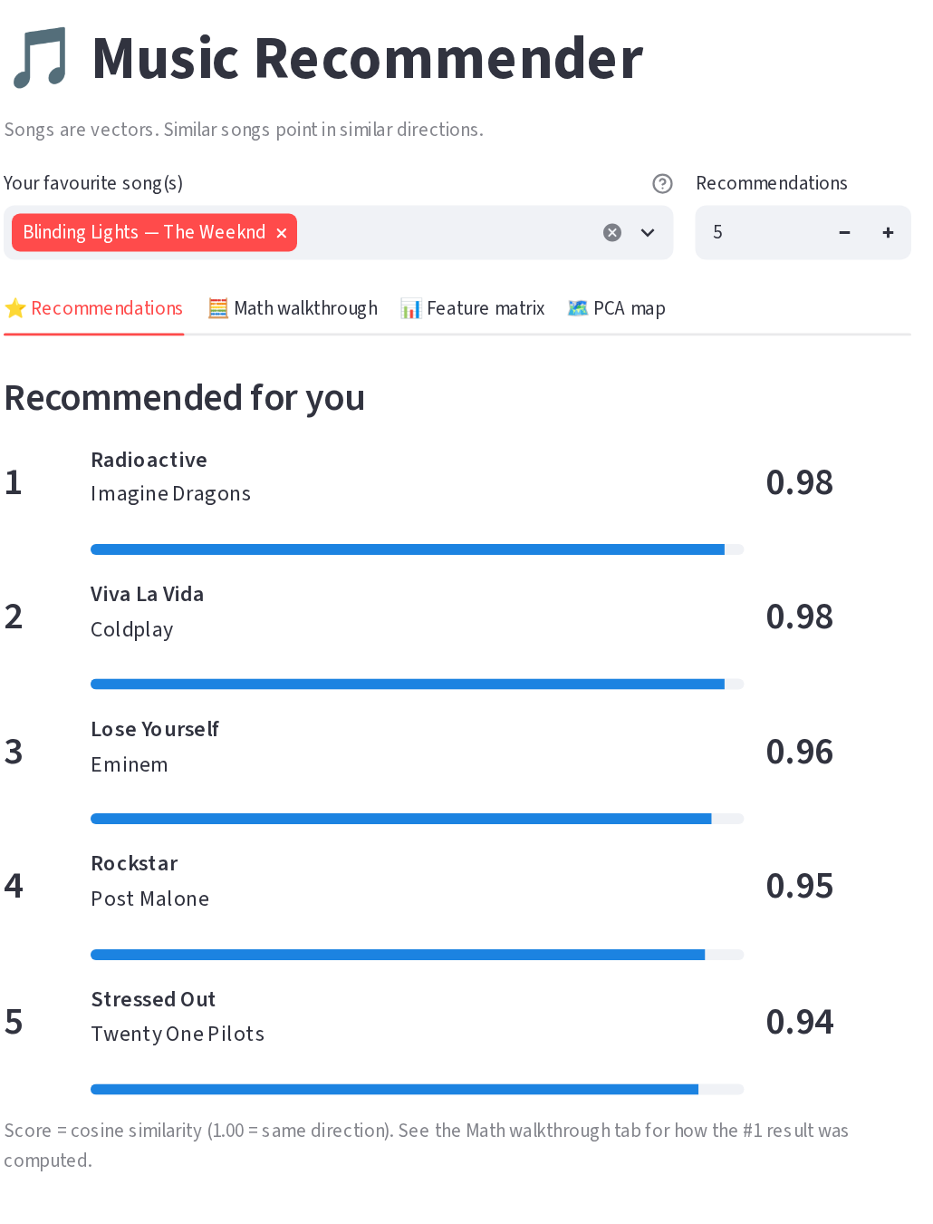
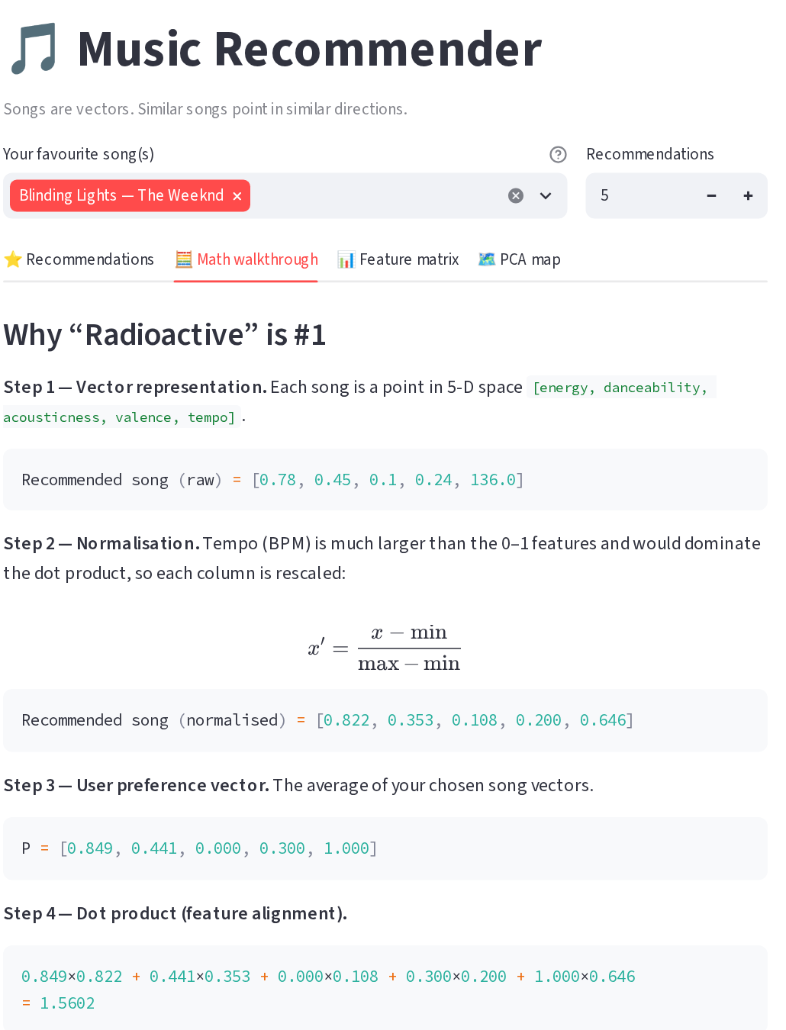
Application Demo · Streamlit Interface
How the app works
Choose one or more favourite songs
Top-N list with cosine scores
Math tab shows each step
Matrix tab and PCA map tabs
Notes:
Live demo: select a favourite song, the app ranks recommendations and shows every mathematical step.

Slide 10
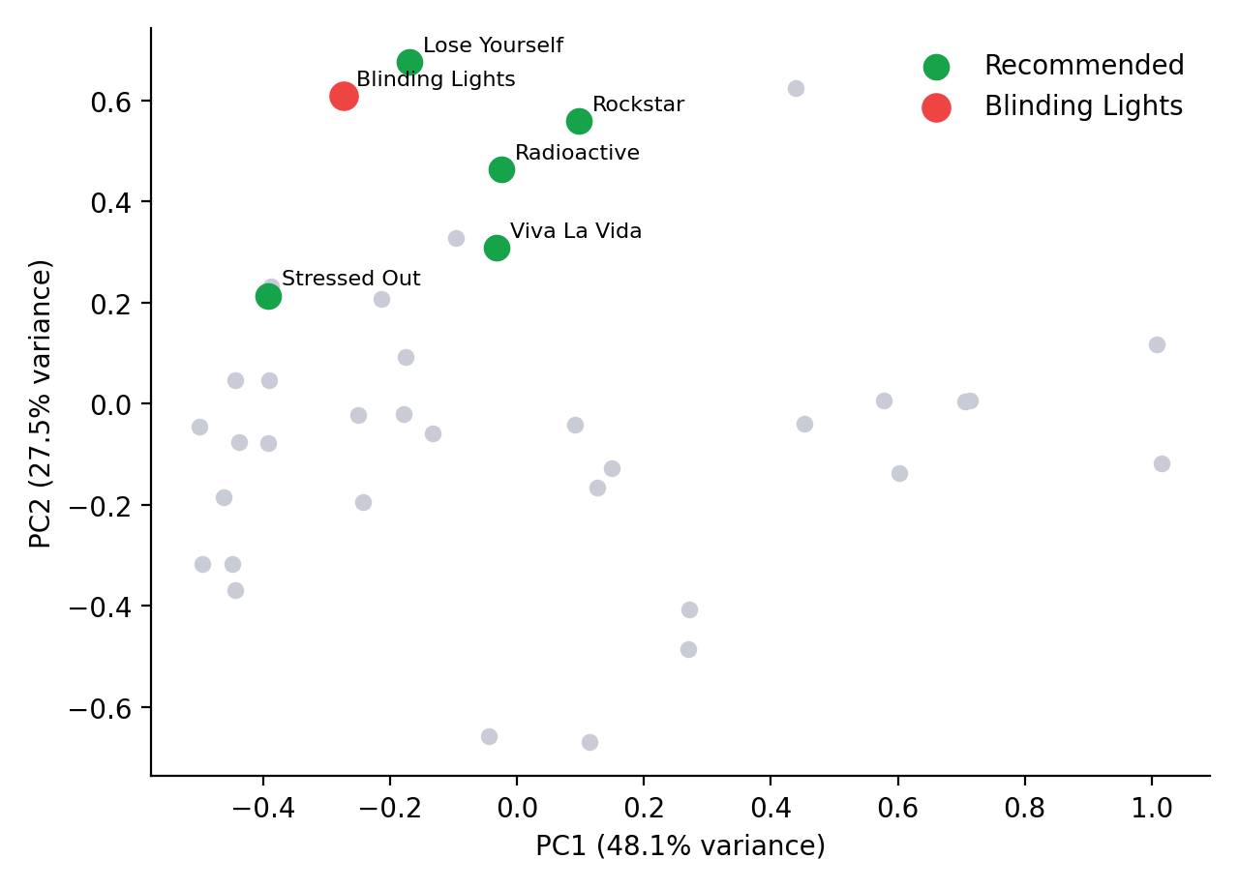
Step 6 · PCA: Eigenvectors and Projection
C = X_cᵀX_c /(n−1)
C v = λ v
Z = X_c · V₂
Result
Eigenvalues: 0.185, 0.106, 0.047, 0.029, 0.018
PC1 = 48.1%, PC2 = 27.5% of variance
Top 2 keep 75.5% of information
5-D → 2-D music map
Notes:
Covariance matrix of centred X; eigen-decomposition; projection onto the top 2 eigenvectors.

Slide 11
Mathematical Concepts: What, Why, Result
Concept | Why used | Result
Vectors and matrix | Represent each song and the whole dataset | 38×5 feature matrix X
Normalisation | Stop tempo (BPM) dominating the other features | All values scaled to [0, 1]
Dot product | Measure feature alignment of two songs | S₁′·S₂′ = 1.5602
Norms | Remove magnitude; compare direction only | 1.4163 and 1.1268
Cosine similarity, angle | Turn alignment into a similarity score | cos θ = 0.9777, θ = 12.13°
Matrix product X̂X̂ᵀ | Score every song pair at once | 38×38 similarity matrix, Top-N list
Projection, eigenvectors, PCA | Reduce 5 features to 2 and visualise | 2-D map, 75.5% variance kept
Notes:
Use this table to answer: which concept, why did you use it, what did it produce.

Slide 12
Conclusion and Future Work
What we achieved
Future work
Vectors & matrix: songs and dataset
Normalisation: fair feature scales
Dot product, norms, cosine: similarity score
One matrix product scores all songs → Top-N
Eigenvectors / PCA: 2-D visual map
Real Spotify dataset
More features and genres
Listening history & weights
Compare with collaborative filtering
Notes:
Summarise what each concept contributed.

